Slide 1
Darcy’s Law - Introduction
CE 544 – BRIGHAM YOUNG UNIVERSITY

Slide 2
Darcy’s Experiment
Darcy did some lab tests on flow through sand in 1856

Slide 3
Darcy’s Law
Darcy experimented with different soils and with different values of L, h₁, and h₂. The results showed that:
where:
q = ΔVol/Δt = flow rate [L³/T]
k = coefficient of permeability
or hydraulic conductivity [L/T]
A = gross cross-sectional area of flow [L²]
h = total head [L]
L = length of flow path [L]

Slide 4
Alternate Formulation
Darcy's law is often written as:
q = kiA
where
i = hydraulic gradient
where s is the flow path length

Slide 5
Darcian vs. Seepage Velocity
Darcy's law can be rewritten as:
q = kiA
v_{d} = ki
v_{d} = "discharge velocity" or "Darcian velocity"
V_{s}
V_{d}
v_{s} = "seepage velocity"

Slide 6
Seepage Velocity
Seepage velocity can be related to discharge velocity as follows:
V_{v} = Volume of soil voids
V = Total volume
n = porosity

Slide 7
Seepage Velocity, cont.
area
n =
total area
n | v_{s}/v_{d}
0.33 | 3
0.5 | 2
0.67 | 1.5
0.75 | 1.3

Slide 8
Effective Porosity
Not all voids in the soil conduct flow.
n_{e} = "effective" porosity
where A_{f} = actual area of flow

Slide 9
Effective Porosity, cont.
n_{e} = λn
λ = effective porosity factor
λ is determined experimentally
λ ≈ 1 for sands and gravels
λ = 0.01 - 0.5 for clays

Slide 10
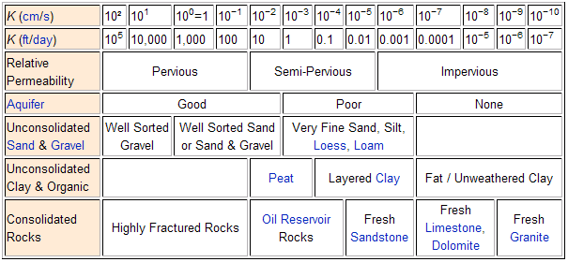
Typical Values of K
http://en.wikipedia.org/wiki/Hydraulic_conductivity

